Slide 1
LS2102 Diffusion in Biology
LS2102 (Autumn 2020)
IISER Kolkata
13-11-2020

Slide 2
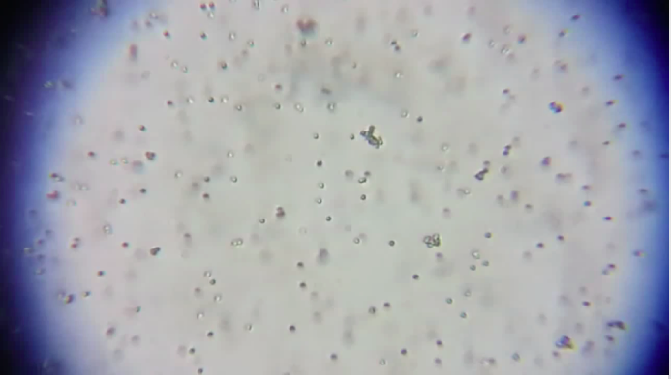
Very small plastic particles in water:
Notes:
Go from macro level to the single molecule level

Slide 3
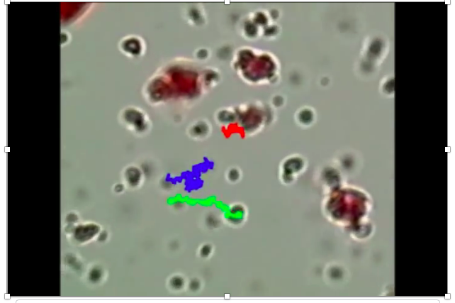
Pond water under the microscope:

Slide 4
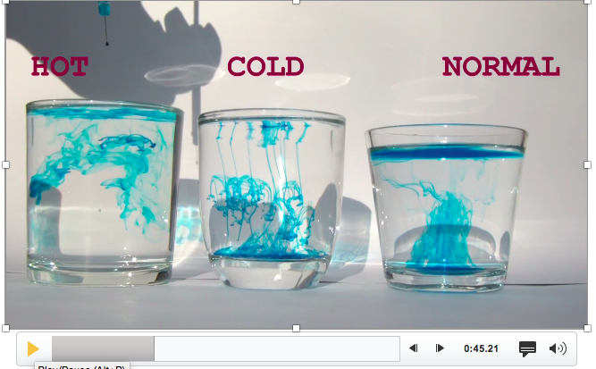
Ink droplet in cold, normal and hot water:
Density (ink) > Density (water)
Notes:
Diffusion

Slide 5
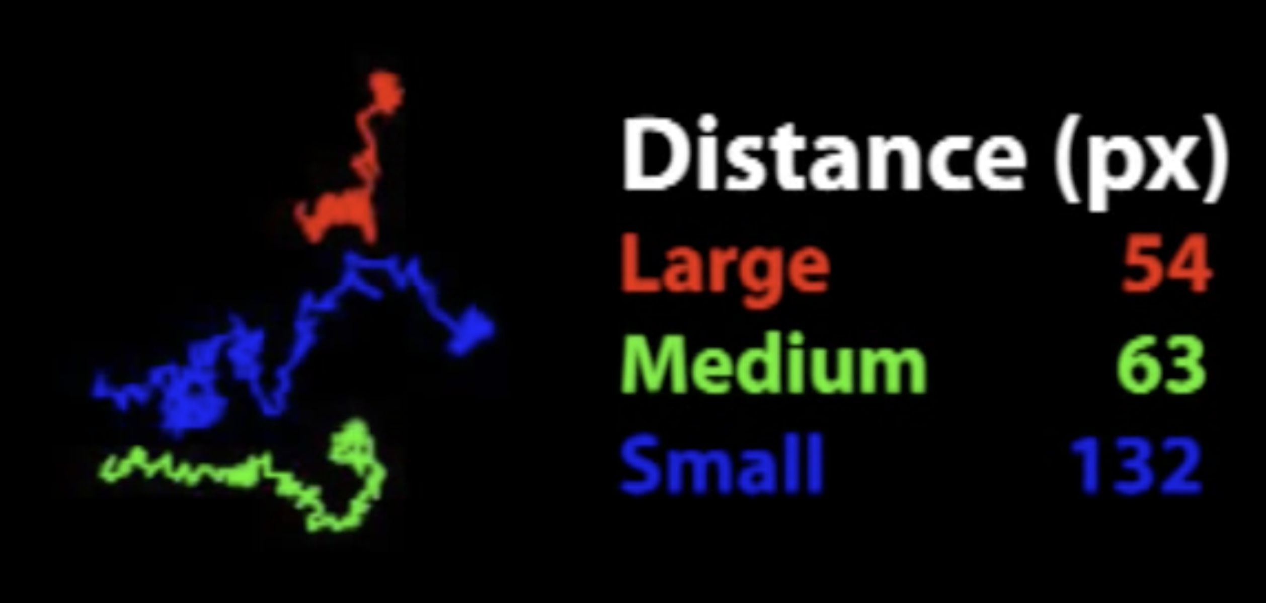
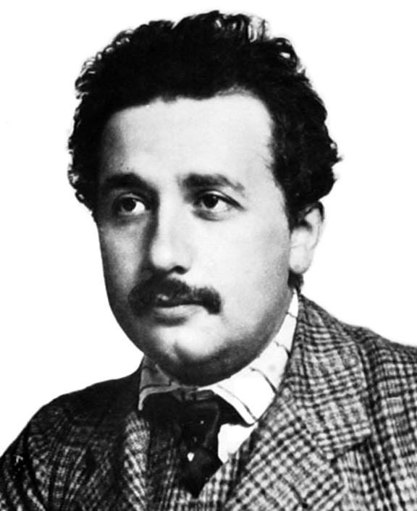
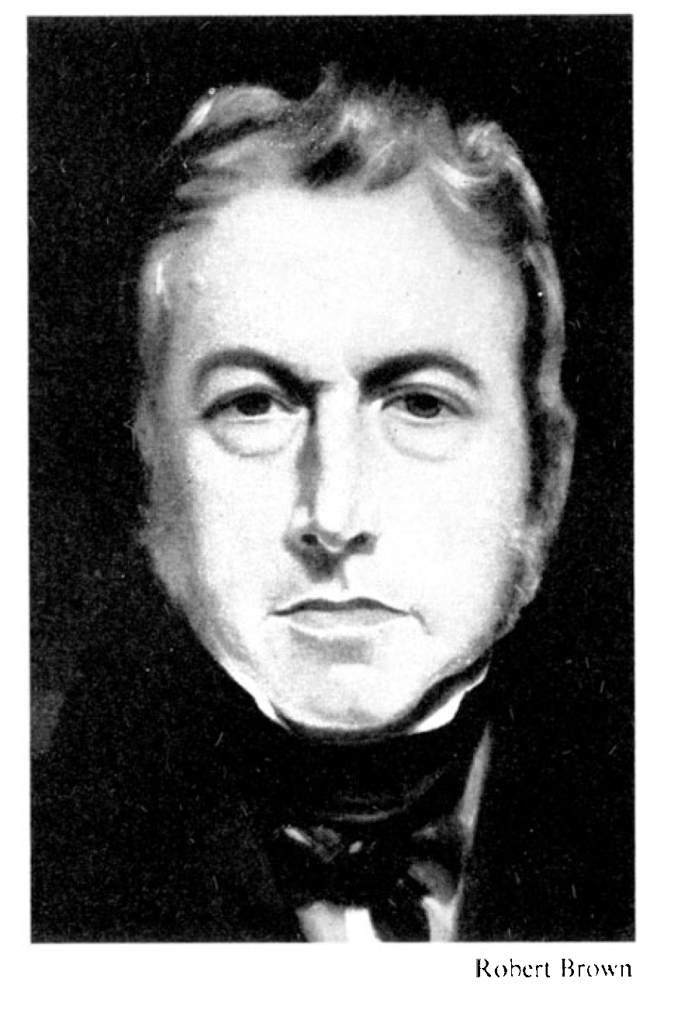
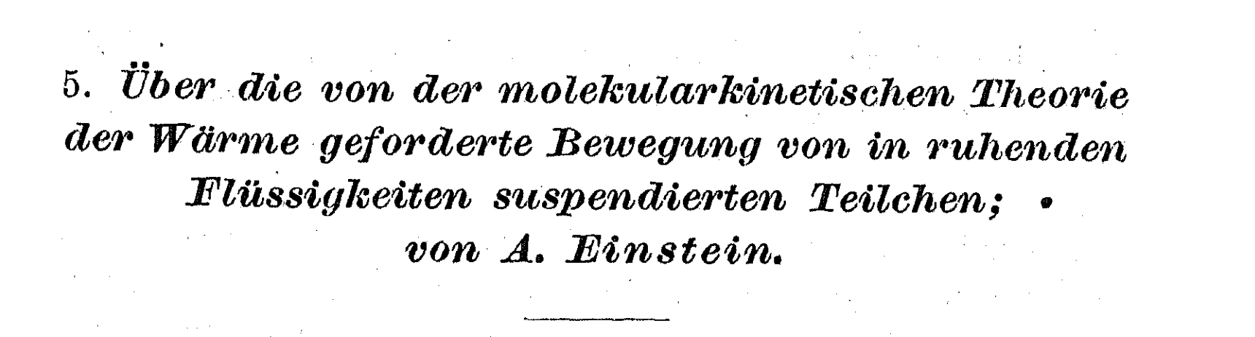
Quantitative Explanation
The explanation was formulated by A. Einstein in 1905
Brownian motion was
discovered by Robert Brown
in 1827
(before the Laws of Thermodynamics were put forward)

Slide 6
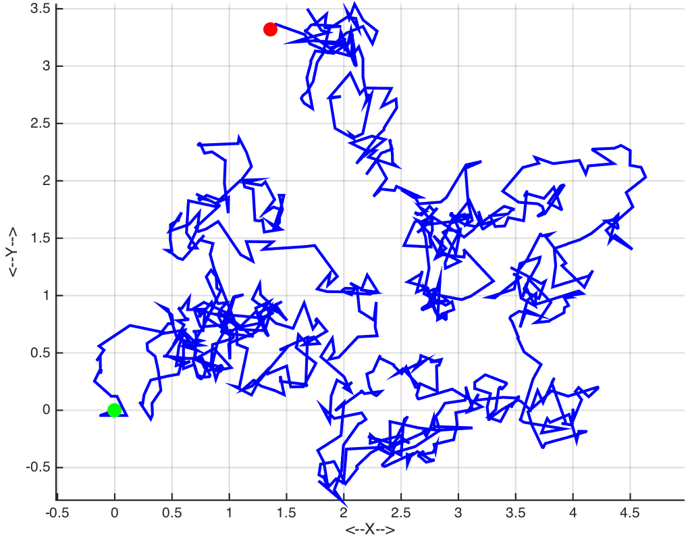
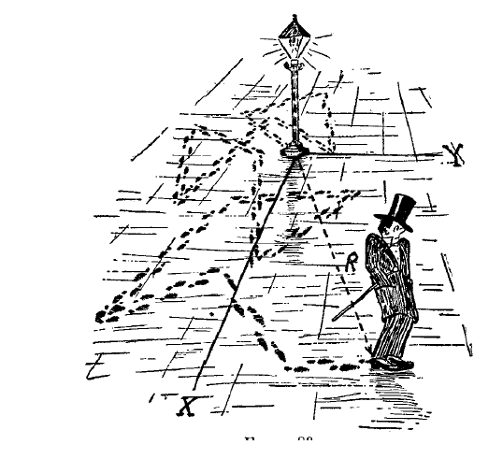
Diffusion: movement of particles in unbiased random walks in any dimension
<Δr²>
General Relationship:
<r_{N}²> = (2d)DT

Slide 7
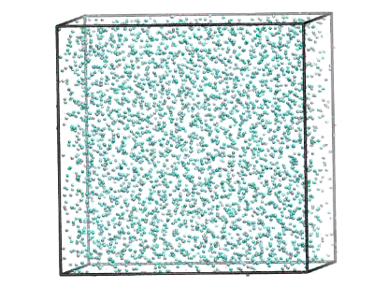
1A. Bulk Liquid - pure (Computer Simulation data)

Slide 8
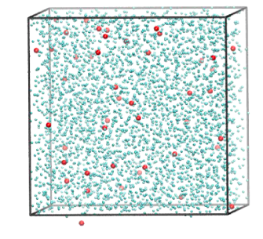
1B. Bulk Liquid – mixture (Computer Simulation data)

Slide 9
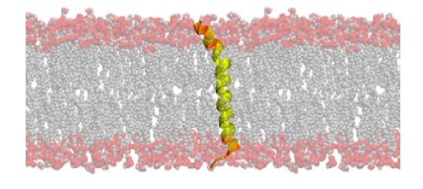
2. Protein fragment within a DPPC Bilayer (Computer simulation data)
Frames spaced by Δt = 10 picoseonds

Slide 10
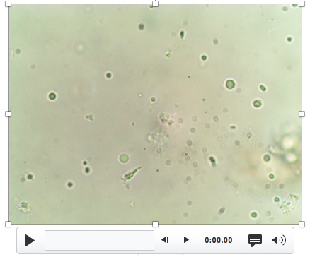
2. Pollen grain in water (Experimental data - Light microscopy)
Frames spaced by Δt = 0.1 seconds

Slide 11
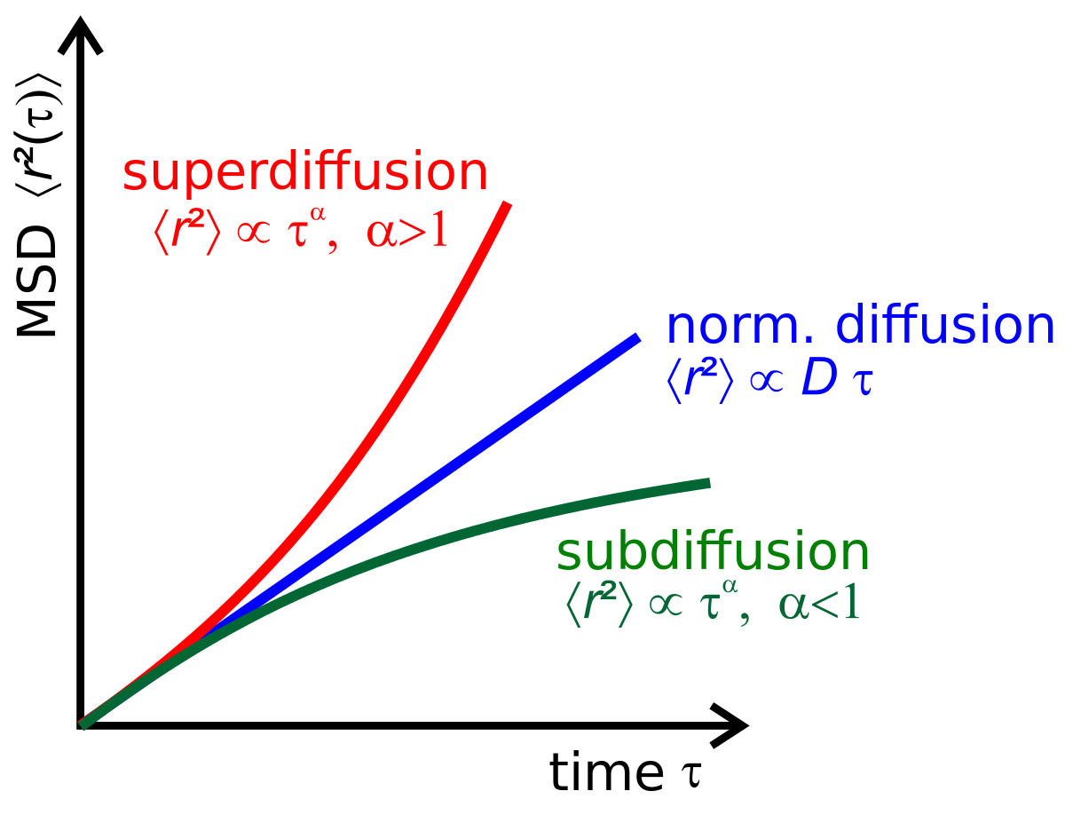
Deviations from linearity:
Linear fits may still be done to extract and compare ‘D’

Slide 12
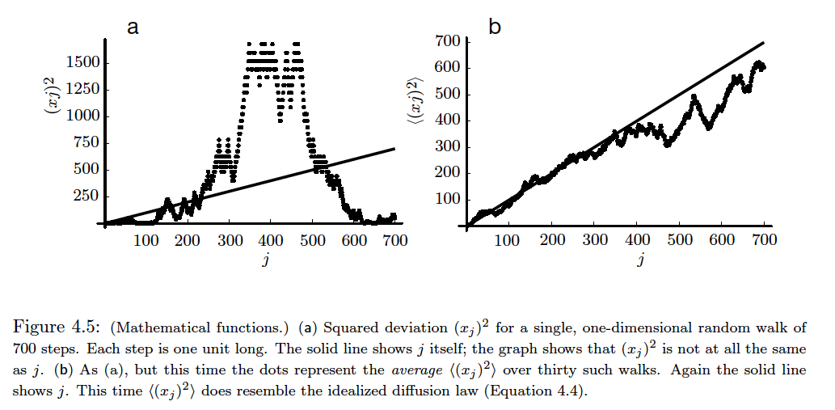
Deviations from linearity:
1. Poor statistics
Nelson, Biological Physics, Ch. 4

Slide 13
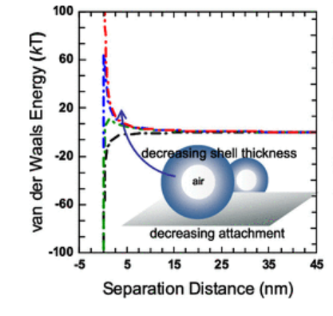
Deviations from linearity:
Particle-Particle Interaction
Movement is not truly ‘random’

Slide 14
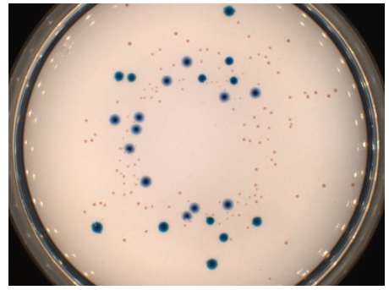
Deviations from linearity:
Finite Diffusion Volume
Spatial restriction and interaction with boundaries (walls)

Slide 15
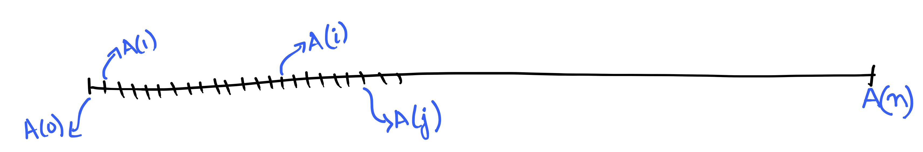

Time Correlation Formalism (TCF)
Time Dependent Physical Quantity: A(t)
Measurement or Computation at discrete time points
Average:
over origin,
over systems
moving time
origin
time ‘t’ after
origin

Slide 16
General Time Correlation Function (TCF) Formalism
Part I
Initialize the correlation function
Decide the correlation time.
General thumb rule: correlation time is (1/10)th of the data set
Part II
Move time origin over the data set
Calculate correlation function over multiple time intervals
Find total correlation for a given time difference (Δt)
Collect the number of times TCF(Δt) is estimated
Part III
Find the Average for each time difference (Δt)
Rescale or Normalize so that TCF(0) 1.0
Part IV
Plot TCF
Extract physically meaningful quantities

Slide 17
Assignment
Q1. Identify Part I, II, III and IV from tcf_av.py
Copy the relevant parts and provide your own comments.
Q2. Identify and write down the mathematical function used in tcf_av.py

